Slide 1
Virtualization

Slide 2
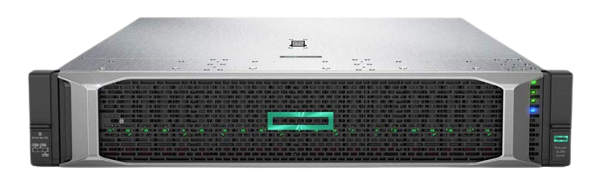
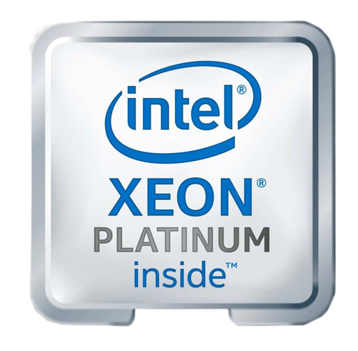
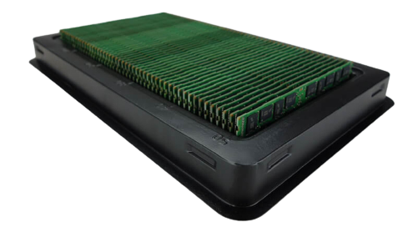
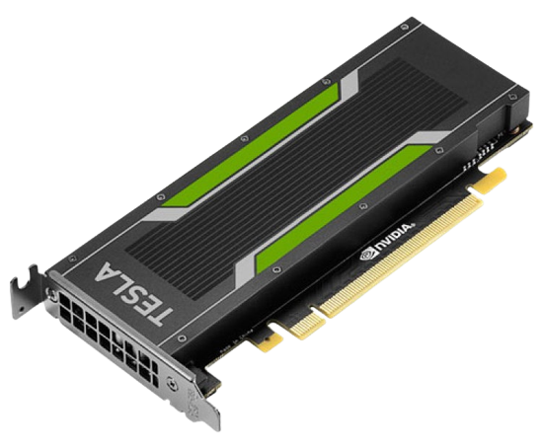
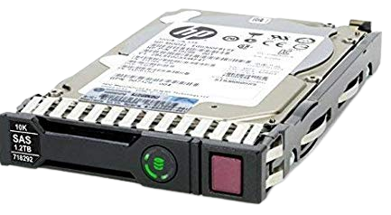
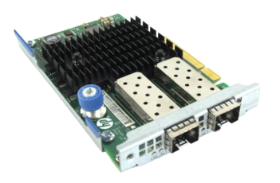
Resource
You can NOT use one physical server for one service with this huge resource
Notes:
Old servers → limited resources
HP DL380 G7 → lunch: 2011 / Retire: 2013 / EOL:2018 / Max resource: 2*6(12) / 384 GB
Blade servers → Smaller resources, Integrated chassis
New servers: HP DL380 G10 → Max: 2*24(48) / 6 TB

Slide 3
Virtualization
“Virtualization is a process that allows for more efficient utilization of physical computer hardware and is the foundation of cloud computing”
IBM
Benefits:
Slash your IT expenses
Reduce downtime and enhance resiliency in disaster recovery situations
Increase efficiency and productivity
Control independence and DevOps
Move to be more green-friendly (organizational and environmental)

Slide 4
Virtualization & Virtual Machine
What we means when we’re talking about virtualization:
Assigning portion of host’s CPU to a VM
Assigning portion of host’s memory to a VM
Maybe some direct access to other host’s resources
Some sort of storage
Some sort of network
…
Hypervisor
So which resources are virtualized?
Any resources attached to MB (e.g. CPU, Memory, GPU, …)
Remote storage
Network
…

Slide 5
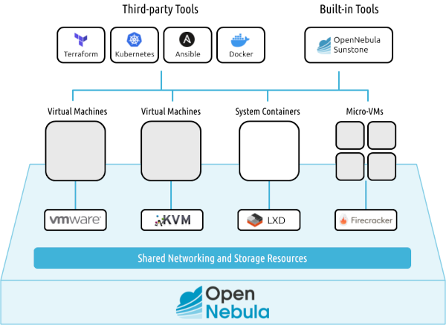
Opennebula
Hypervisor

Slide 6
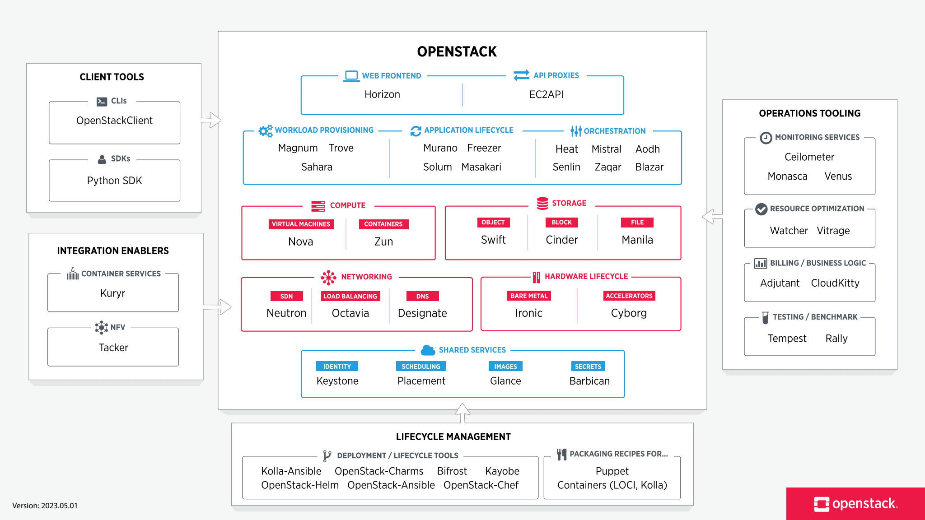
Openstack
Hypervisor

Slide 7
What is Hypervisor
App
App
OS
OS
Emulation is possible here
Hardware
Hardware
Hypervisor
Hypervisor - Type 2
OS
System, user, …
Kernel
Hypervisor - Type 1
Hardware

Slide 8
Hypervisor Type 1
App
App
OS
OS
Hardware
Hardware
Hypervisor
Hardware

Slide 9
Hypervisor Type 2
App
App
OS
OS
Hardware
Hardware
Hypervisor
OS
Hardware

Slide 10
Similarity of virtualization & containerization
App
App
App
App
OS
OS
System, User, …
System, User, …
Hardware
Hardware
Hypervisor
System, User, …
OS
Kernel
Hardware
Hardware

Slide 11

How about network?
App
App
OS
OS
Let’s check these out
Hardware
Hardware
NIC
NIC
Hypervisor
vNIC
OS
vNIC
vNIC
vSW
vSW
Hardware
NIC
NIC

